Slide 1
Reddit
Project
Renata, Oliver, Daniel

Slide 2
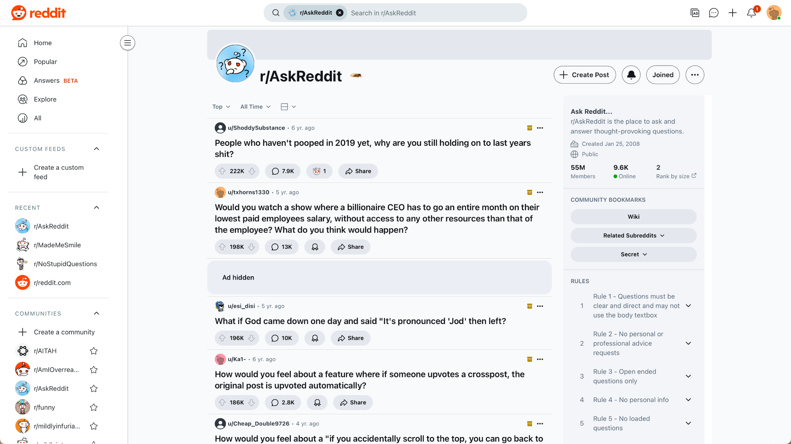
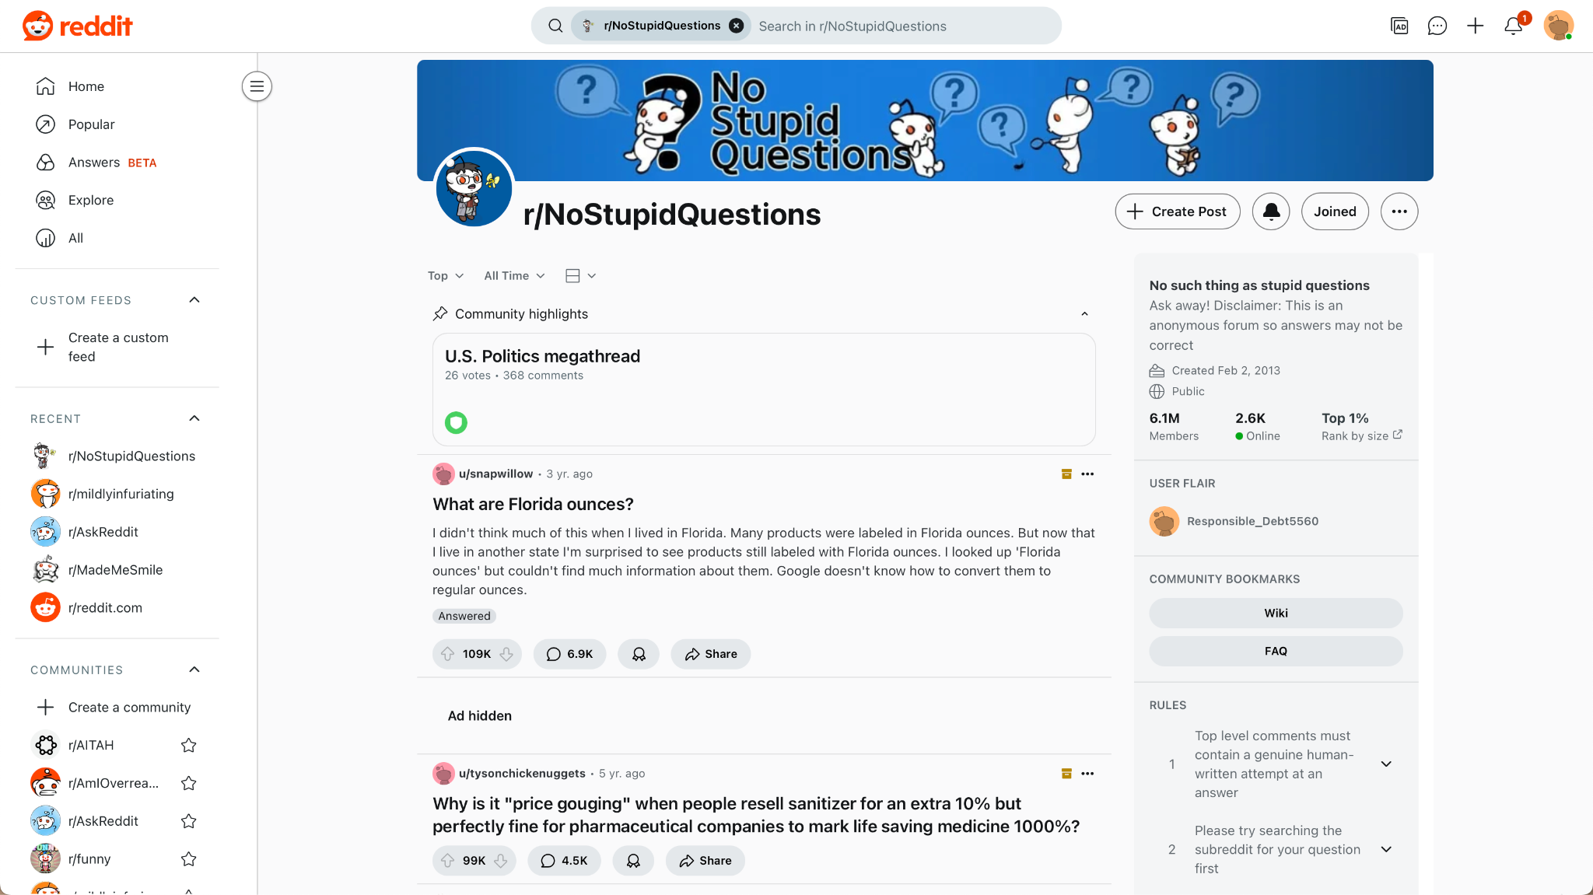
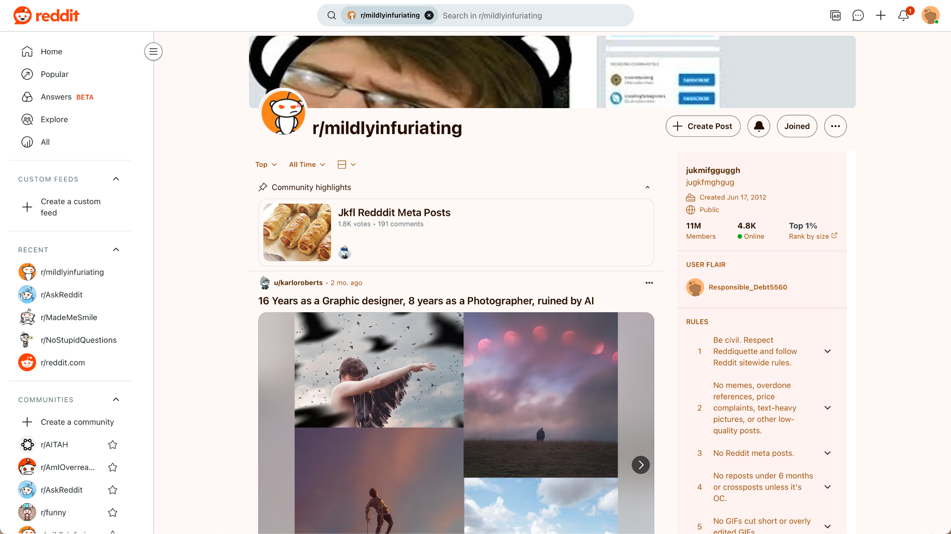
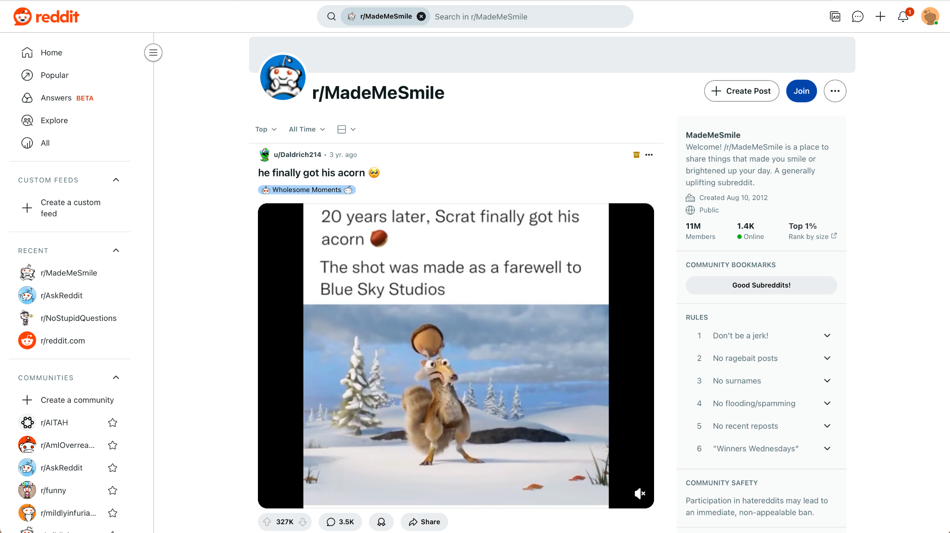
Data
Extracted Top 50 Comments from Top 100 Posts filtered by Top All Time Posts
Final Combined File: 19000+ Comments
No
StupidQuestions
Mildly
Infuriating
MadeMe
Smile
AskReddit

Slide 3
Top 10 Words in Comments
No
StupidQuestions
Mildly
Infuriating
MadeMe
Smile
AskReddit
Like: 989
People: 960
Time: 818
Know: 681
Think: 628
Work: 628
Get: 623
Go: 613
Year: 613
Day: 601
People: 1170
Like: 1030
Time: 826
Think: 702
Know: 605
Work: 604
Thing: 578
Want: 541
Go: 541
Good: 509
Like: 666
People: 422
Get: 373
Time: 358
Go: 318
Know: 311
Look: 288
Think: 279
Want: 268
Work: 255
Like: 617
Love: 404
People: 398
Good: 379
Get: 337
Kid: 303
Look: 297
Time: 297
Go: 288
Man: 279

Slide 4
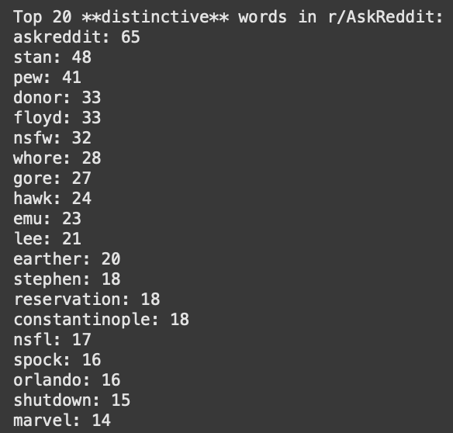
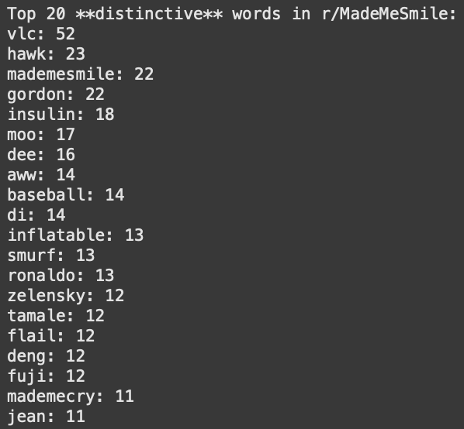
Top 20 Distinct Words

Slide 5
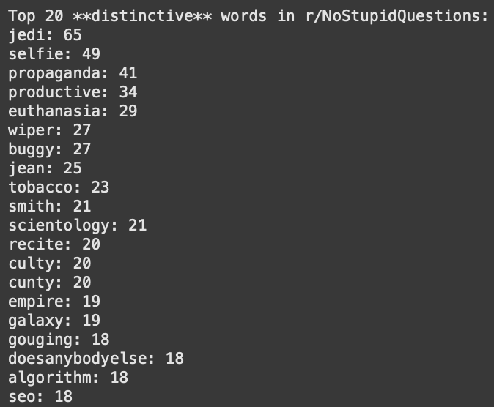
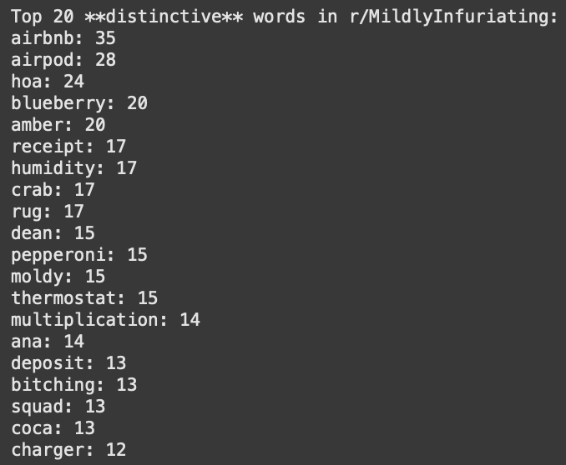
Top 20 Distinct Words

Slide 6
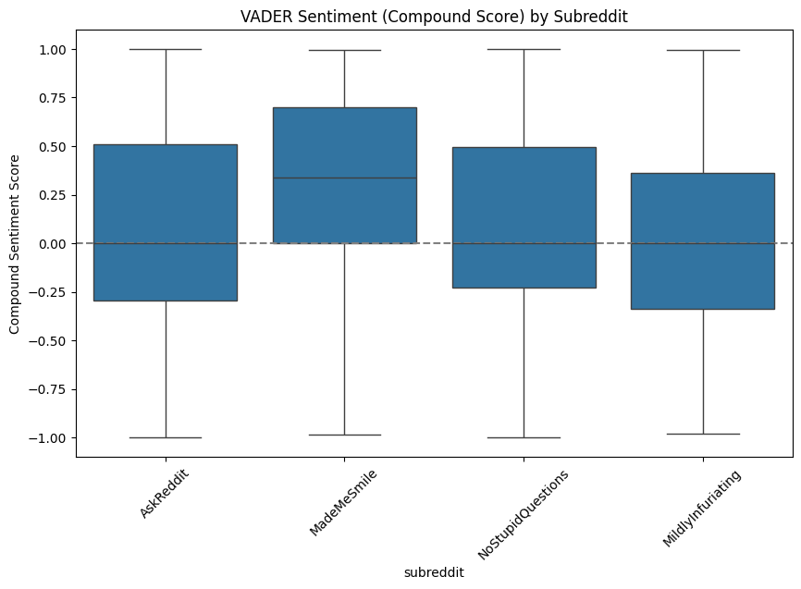
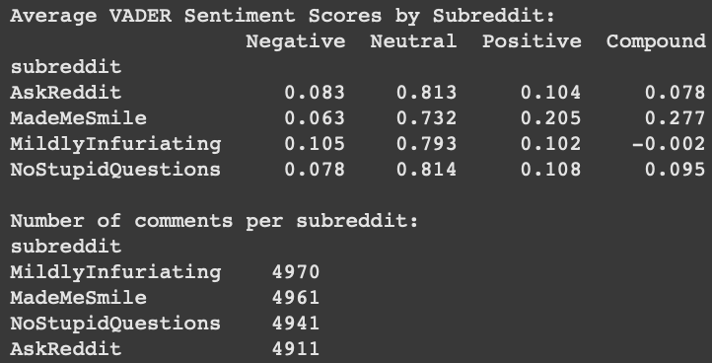
Sentiment Analysis
MadeMeSmile most positive
MildlyInfuriating most negative
AskReddit highest range

Slide 7
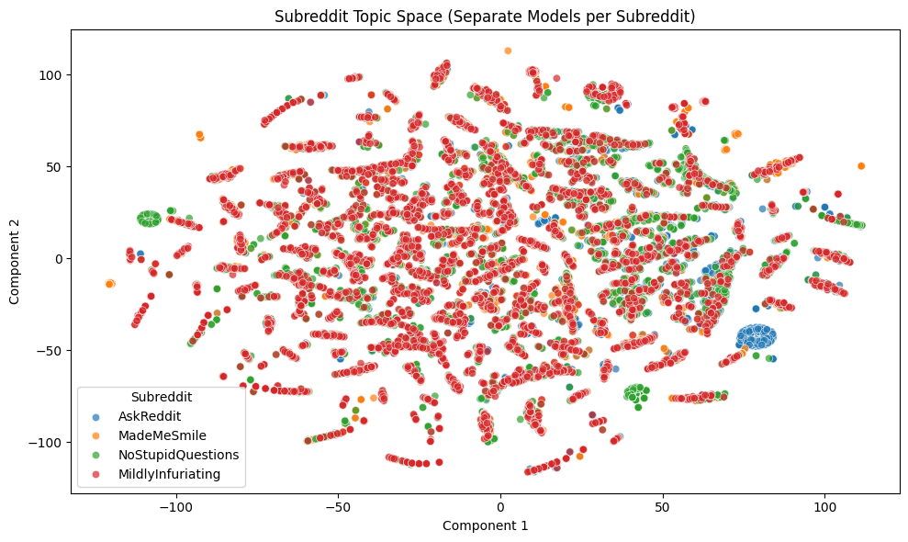
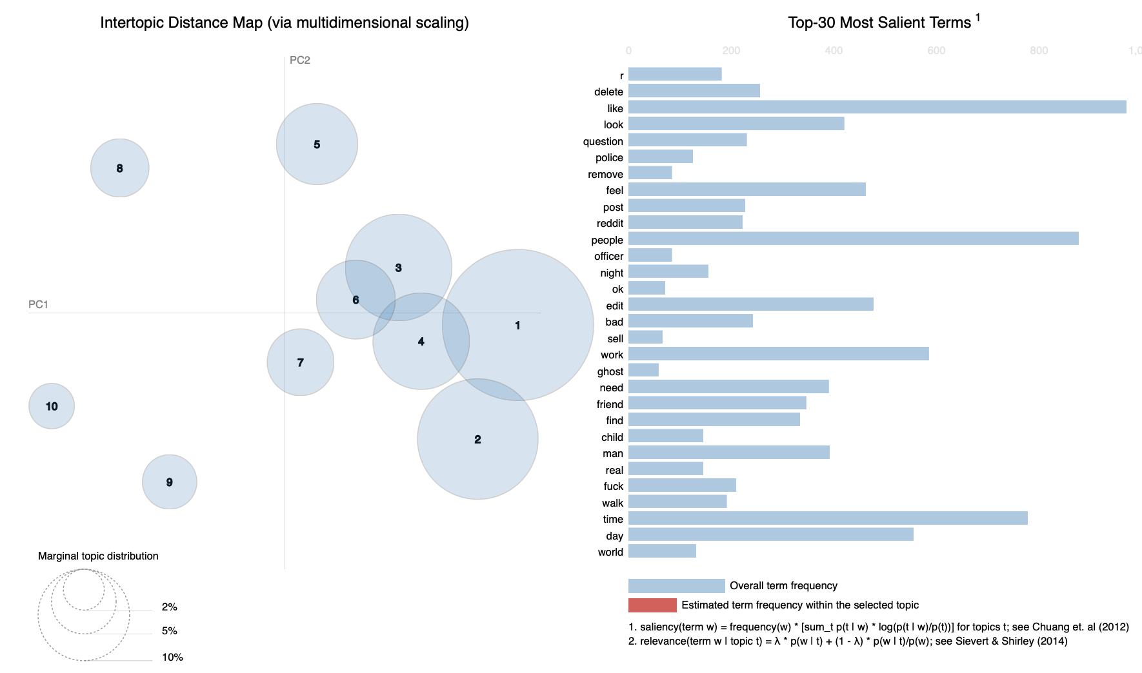
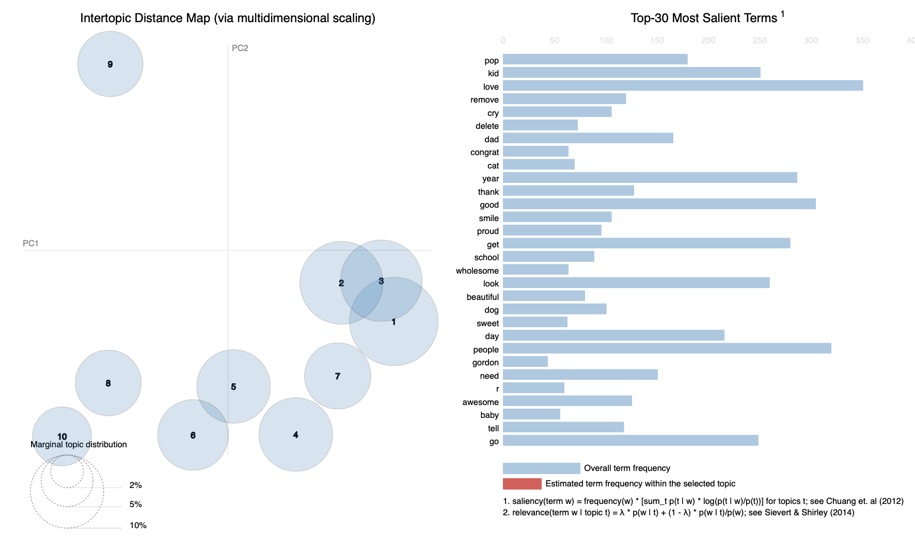
Topic Analysis and Distribution
AskReddit
MadeMeSmile

Slide 8
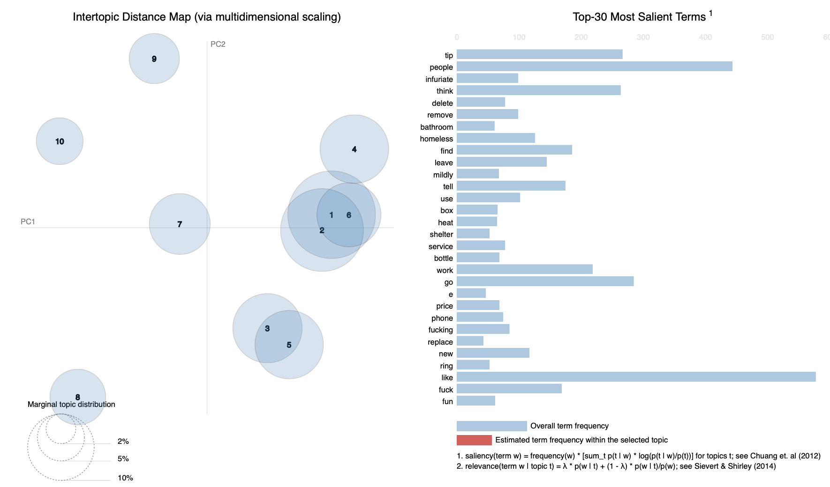
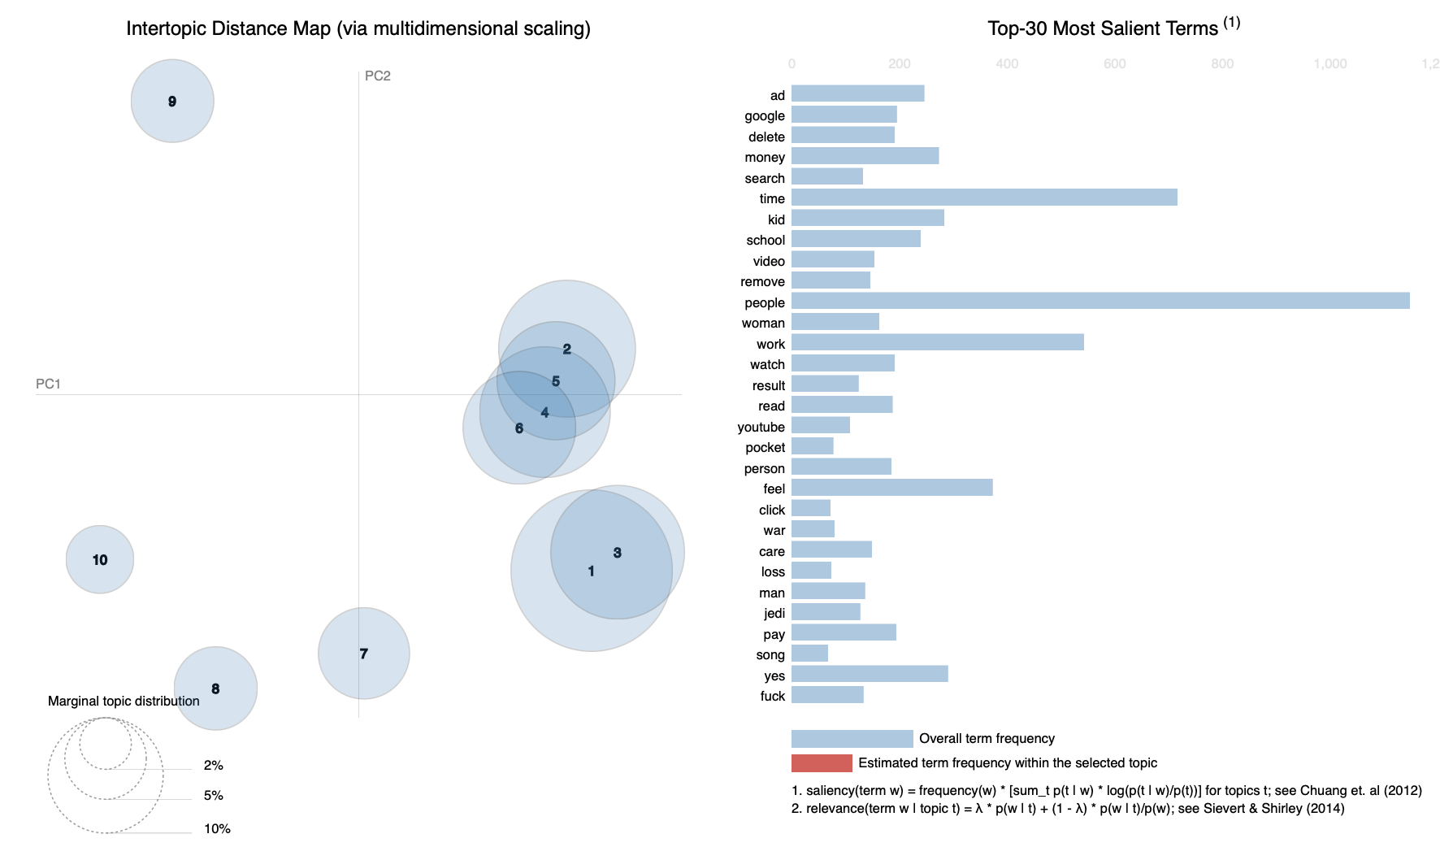
Topic Analysis and Distribution
MildlyInfuriating
NoStupidQuestions

Slide 9
What Makes A Distinct Community?
Reddit:
Reddit users themselves
Interactions with subreddits
Positive emotions
Negative emotions

Slide 10
What Makes A Unique Community?
Reddit:
Posts/comments less likely to be negative
Moderators
Large amount of diversity among posts/comments
MadeMeSmile (most diverse)
Other three similar

Slide 11
What Conflicts Does The Community Have?
Not much conflict (neutral sentiment):
Culture of Reddit: more likely to agree (productive conversations)
If things get out of hand, comments may be banned

Slide 12
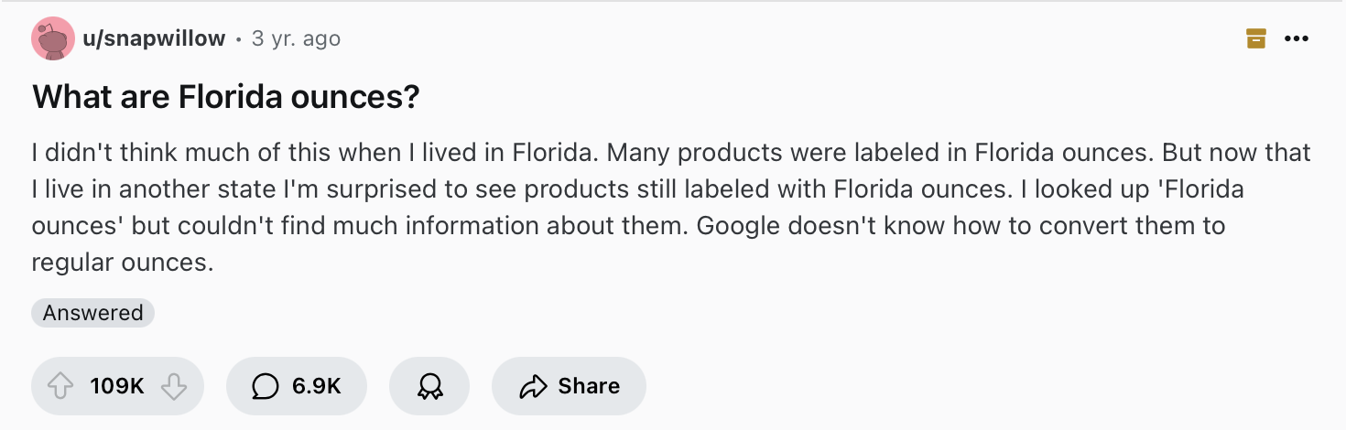
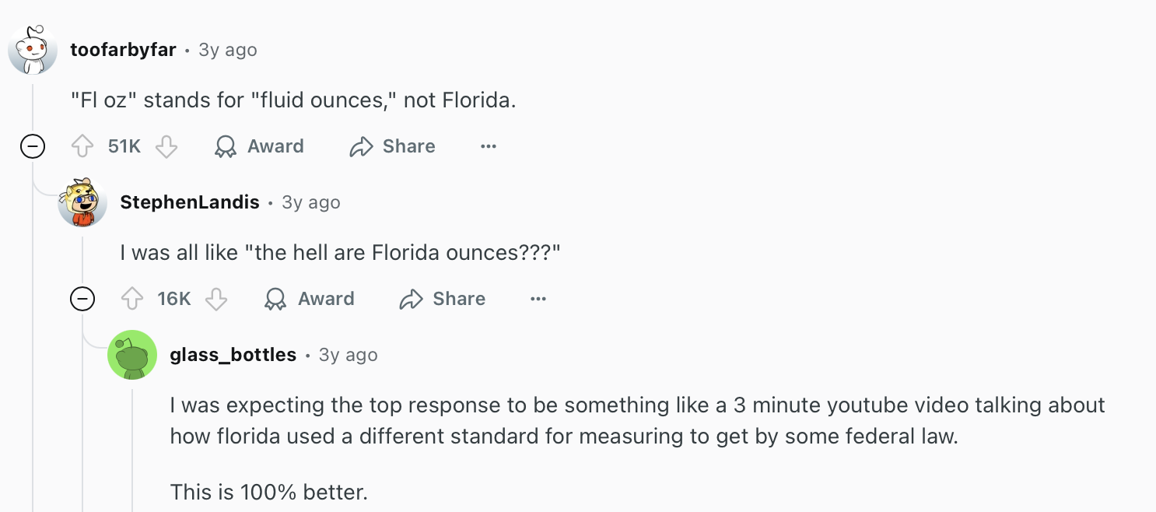
What Makes People Want to Join?
To feel good/not being judged (pseudonymous)
No question too stupid to ask
Ironic/humorous

Slide 13

Python Libraries
Pandas
SpaCy
VADER
Gensim
Matplotlib
Seaborn
pyLDAvis

Slide 14
Questions?

